Slide 1

Feature Extraction and Price Prediction for Mobile Phones By Pavan Kumar

Slide 2
INDEX 1. Objective 2. Importing Dataset 3. Handling Missing Values.. 4. Feature Engineering. 5. Handling Categorical Data.. 6. Implementing Machine Learning Model. 7. Feature Importance Analysis.

Slide 3
Objective To build a predictive model that can accurately estimate the price of a mobile phone based on its features. In this project, We will work with a dataset that contains detailed information about various mobile phones, including their model, color, memory, RAM, battery capacity, rear camera specifications, front camera specifications, presence of AI lens, mobile height, processor, and, most importantly, the price.

Slide 4
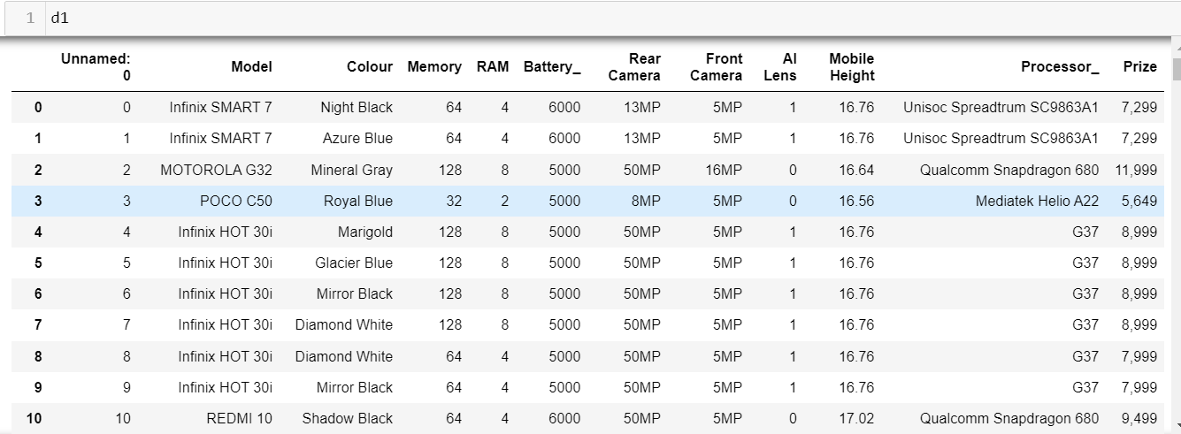
Importing Data Set: 1) Importing the Data Set: a) For Importing the Dataset we have First Imported the Pandas Data Frame and then we have used the below Code: import pandas as pd d1=pd.read_csv(r"E:\DIGI chrome\Data sets\Processed_Flipdata - Processed_Flipdata.csv")

Slide 5
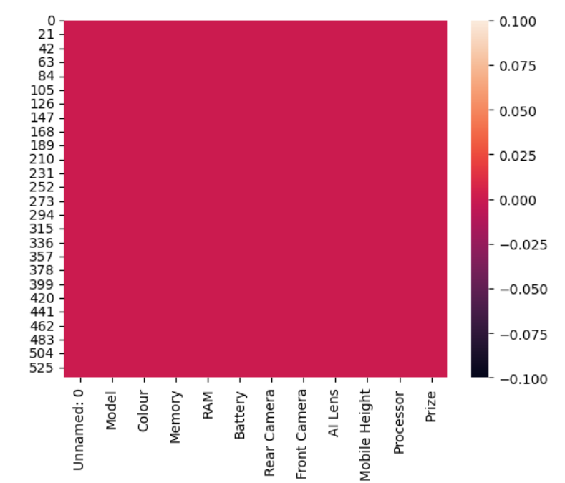
Handling Missing Values 1) Handling Missing Values : We have checked any missing values are present but there is no missing values. Import seaborn as sns sns.heatmap(d1.isnull()) 2) Duplicated data: And also we have checked any duplicates are there but there are no duplicates. d1.duplicated().any()

Slide 6
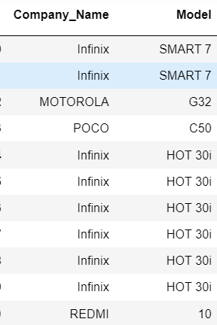
Feature Engineering: 1) Feature Engineering : If we see the Column Model the Name of the Company and the model both are been combined so I have been separated them into to parts. 1) Company_Name 2) Model by using below code: company=[], model=[] for i in d1['Model’]: j=i.split(" ")[0] company.append(j) k=len(j) l=i[(k+1):] model.append(l) d1.insert(0,'Company_Name',company) d1['Model']=model

Slide 7
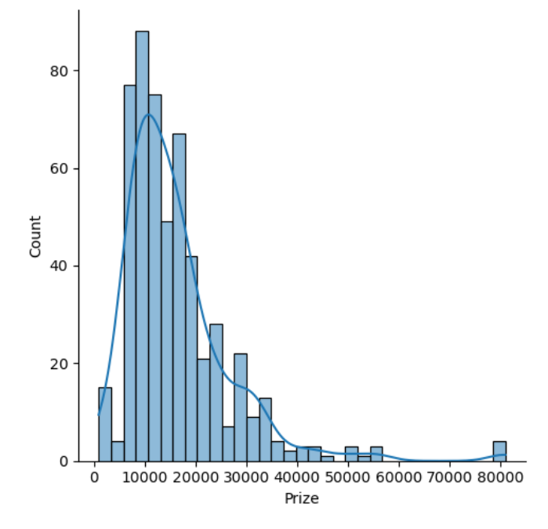
Handling Outliers 1) Handling Outliers: a) For handling the Outliers I have used the IQR Method , For that first we have to find the upper bond and lower bond and then we have update the values or delete the rows which has the value greater than upper bond and lower bond. upper_limit = Q3 + (1.5 * IQR) lower_limit = Q1 - (1.5 * IQR) d1.loc[d1[x] > upper_limit, x] = upper_limit d1.loc[d1[x] < lower_limit, x] = lower_limit

Slide 8
Handling Categorical Data 1) Handling Categorical Data : If we see the dataset the are categorical variables , In which the Machine cannot be understood so we have to change the categorical data into numeric data , If we see the columns Rear Camera , Front Camera Column Except “MP” the remaining data is in numeric so we have to remove that “MP” it will be converted into numeric so I have used the replace method for that. If we see the remaining columns like Company Name , Model, Processor, color For those Columns we have use the Label Encoder.

Slide 9
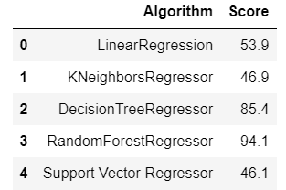
Machine Learning Model 1) Machine Learning Model: For our dataset we have Predict the Price of the Mobile, For Prediction Purpose we have to use Regression so I have implemented different algorithms like Linear Regression, KNeighbors Regressor, Decision Tree Regressor, Random Forest Regressor and Support Vector Regressor. 2) Among the Algorithms The Random Forest Regressor give high accuracy testing result hence we say that it is te best algorithm for this model.

Slide 10
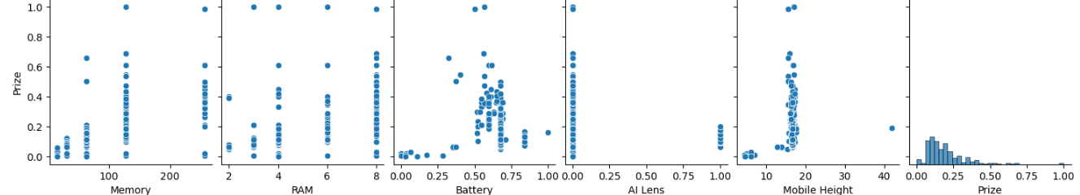
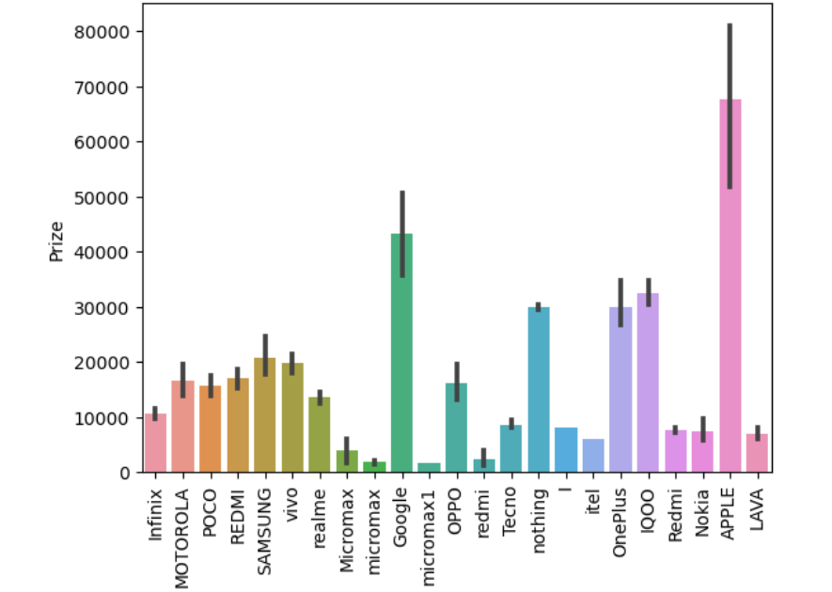
Feature Important analysis: 1) Feature Important Analysis : If we see the Diagram it is clearly says that the sale price of the Apple has more compare to other , It means the Price of the Apple Mobile Phone is higher.

Slide 11
Thank You!

